Slide 1

LEADERSHIP ACADEMY GRADUATION
MARYLAND 2025 CONFERENCE

Slide 2
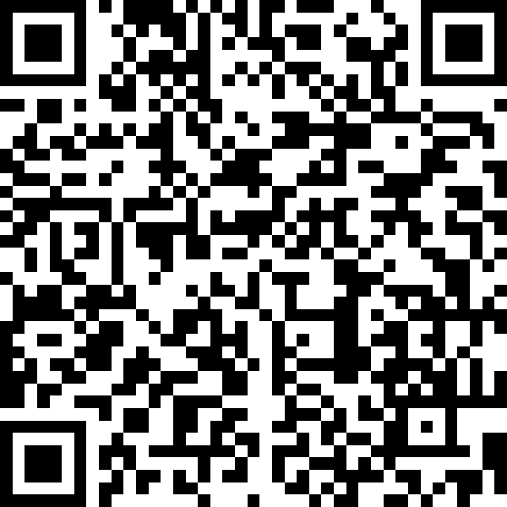
Strategic Plan
5 Goals
  Prioritize Community Engagement and Service
  Targeted Social Action Programming
  Strengthen Member Engagement
  Mentorship
  Professional Development and Education
Scan here for full strategic plan

Slide 3
Strategic Plan | Goals and Initiatives
Professional Development and Education
  Leadership Development Program
  Training and Education Modules
  Prosecutorial Pitfall Programming

Slide 4
LEADERSHIP ACADEMY COMMITTEE

Slide 5
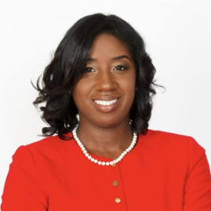
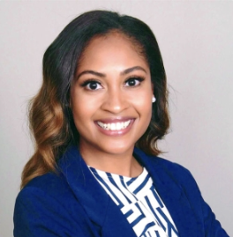
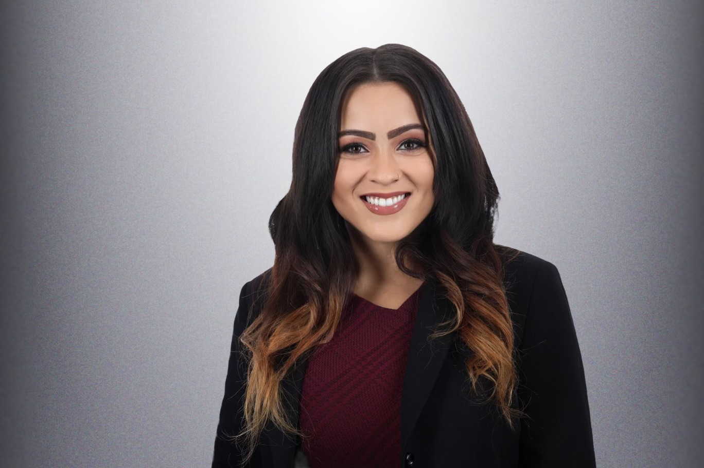
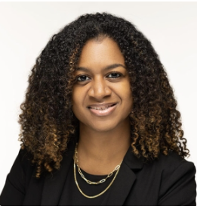
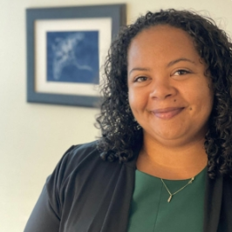
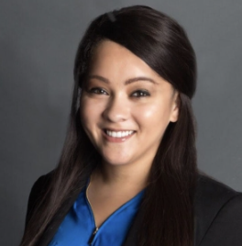
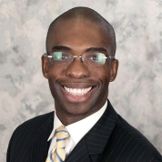
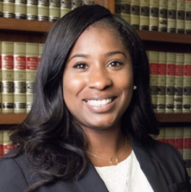
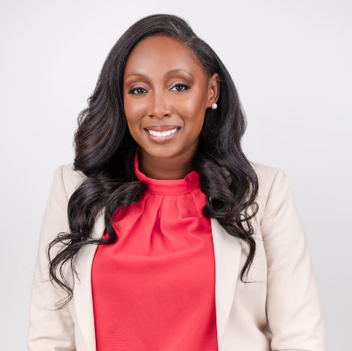
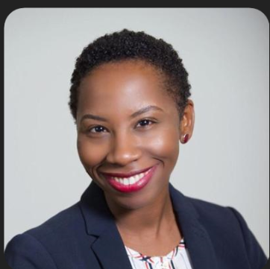
SIMONE HYLTON
President
KRISTINA MILLS
President-Elect
CASEY CONZATTI
Leadership Academy Chair
Pacific Northwest Regional Director
LAURYN A. DAY
Vice President of Planning
ANDREA WILLIAMS
Vice President of Programs
GERMAINE CORPREW
Treasurer
TAYLOR MORRISON
Southwest Regional Director
TYSHAWN JACKSON
Assistant District Attorney
KYONTHA D. NELSON
Organizational Leadership Development Committee Chair

Slide 6
AGENDA

Slide 7
March 15, 2025
March 22, 2025
April 12, 2025
April 26, 2025
What does leadership look like in prosecution?
Former Chief Assistant State Attorney, Miami-Dade State Attorney’s Office
Former U.S. Attorney, Eastern District of Maryland
How do you want to be a lead as a prosecutor?
District Attorney, Bronx County, NY
Former U.S. Attorney, Eastern District of Texas
Should I be a leader?
Litigation Strategy Counsel, Allstate Insurance Company & Organizational Design and Effectiveness Consultant, Leadership Institute of Tampa
How do I build my brand?
Director of Prosecution Projects, Florida International University, Jack D. Gordon of Public Policy
How do I network effectively?
Principal Owner, L.A. Law Firm, P.A. & Candidate for Florida House of Representatives District 107 Leader
Should I seek office?
Washington Attorney General
week one
week two
week three
week four

Slide 8
week four
Should I seek office?
Washington Attorney General
What do I need to know about campaign finances?
District Attorney, Henry County, Georgia
Associate Chief Counsel, Georgia Institute of Technology
What do I say on the campaign trail?
Deputy County Attorney, Utah County Attorney’s Office
Now that I’m a leader, what’s next?
State Attorney, 17th Judicial Circuit, Broward County, Florida
Former U.S. Attorney, Western District of North Carolina
How to build an effective and dynamic leadership team
Former U.S. Attorney, Middle District of Louisiana
Solicitor General, Gwinnett County, Georgia
Capstone Presentations
Capstone Presentations
April 26, 2025
May 3, 2025
May 17, 2025
May 24, 2025
May 31, 2025
week five
week six
week six - seven

Slide 9
CAPSTONE PROJECT

Slide 10
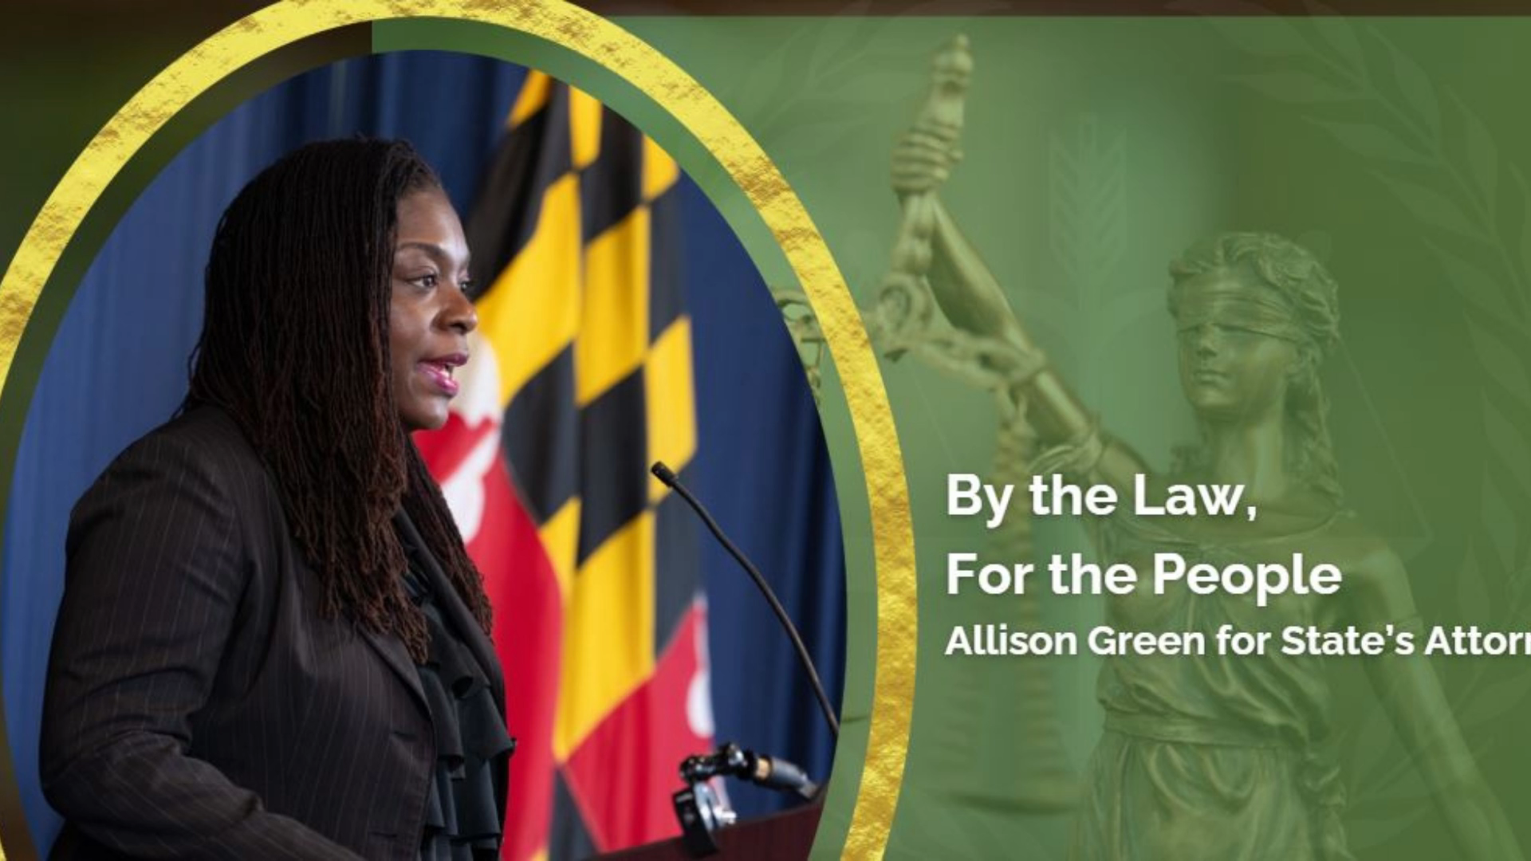

Slide 11
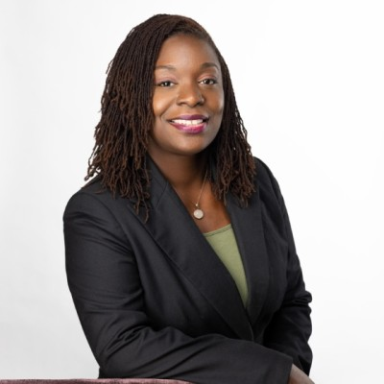
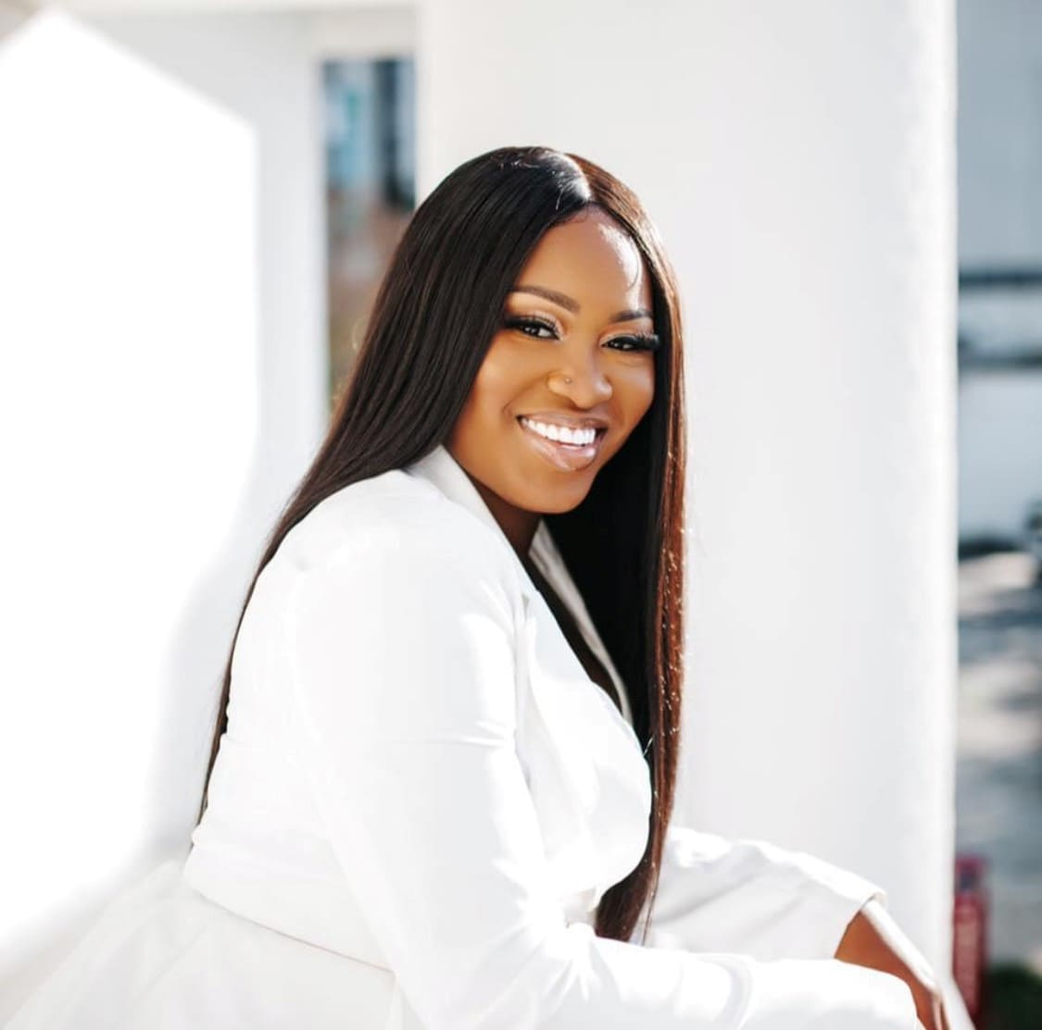
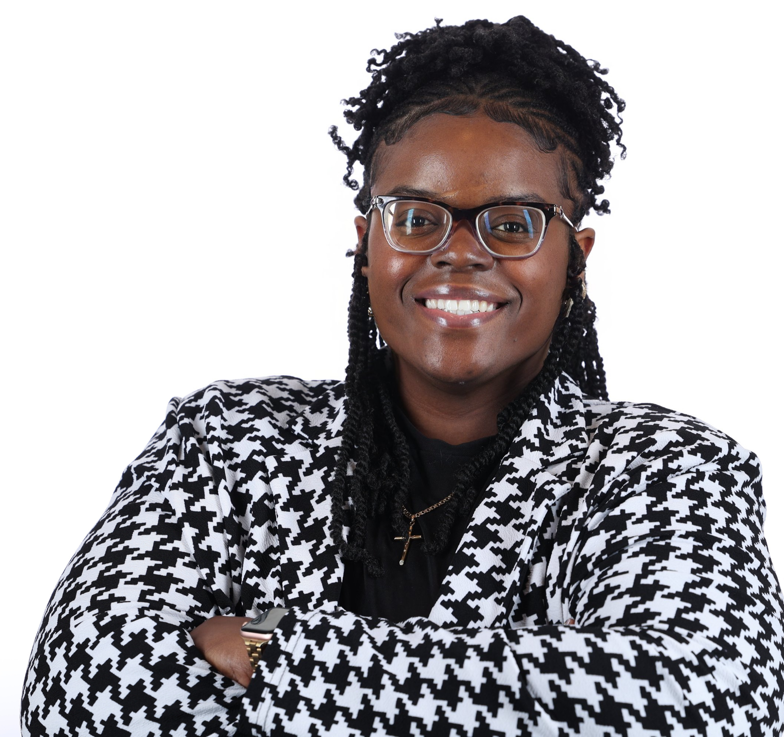
Cohort Speakers
Allison V. Green
Freddelle Menard
Jessica Etienne

Slide 12
Congratulations to the
Inaugural
Leadership Academy
Cohort

Slide 13
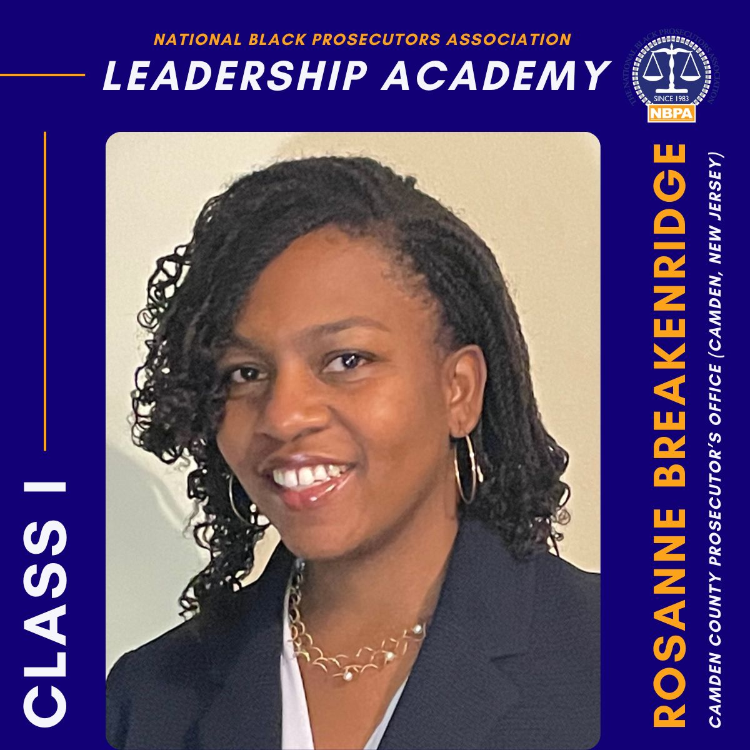

Slide 14
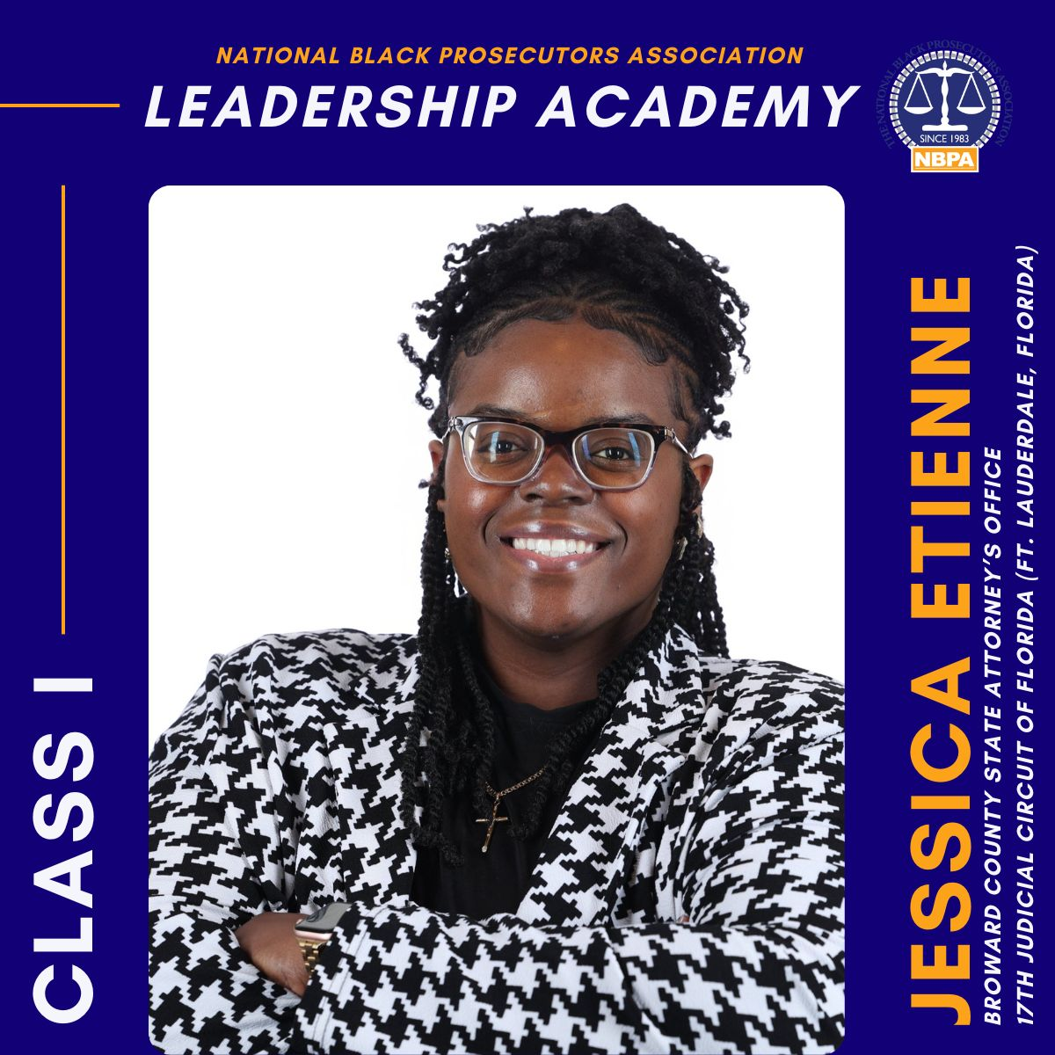

Slide 15
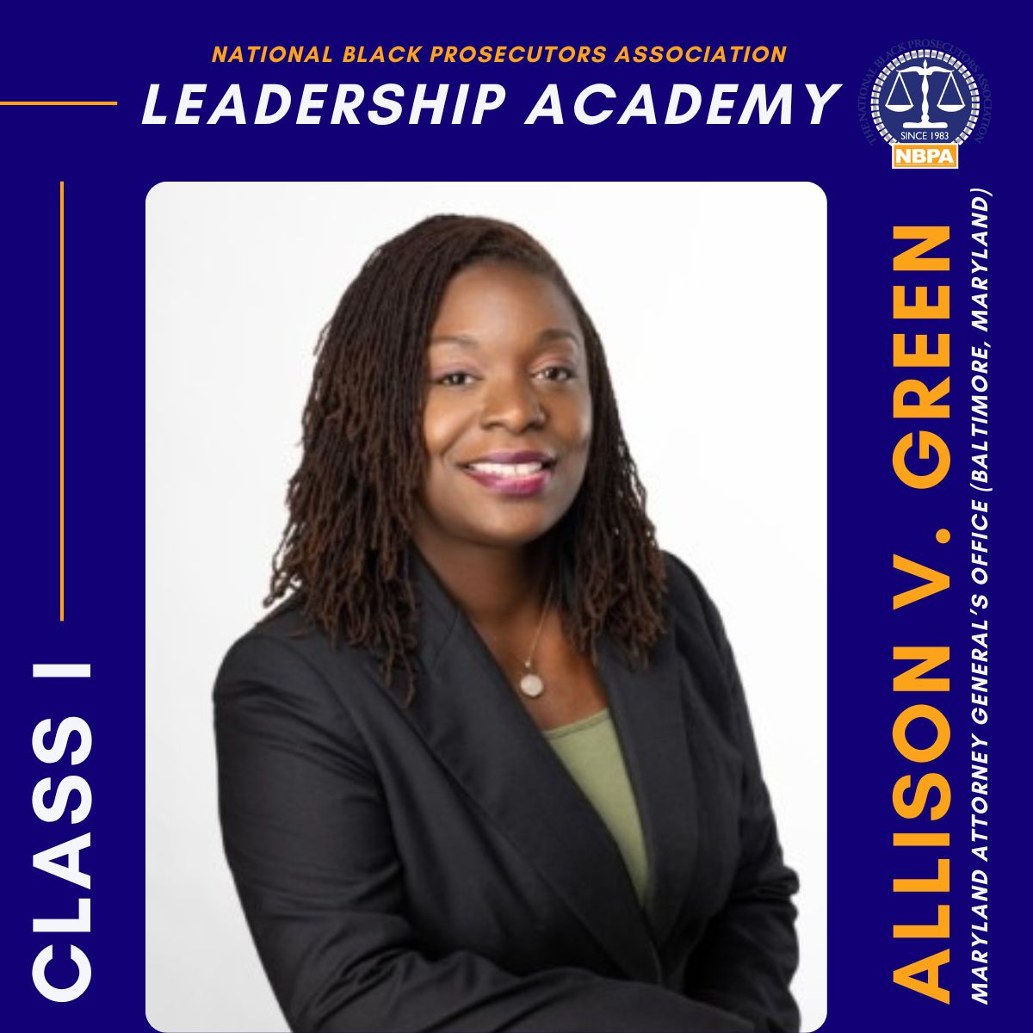

Slide 16
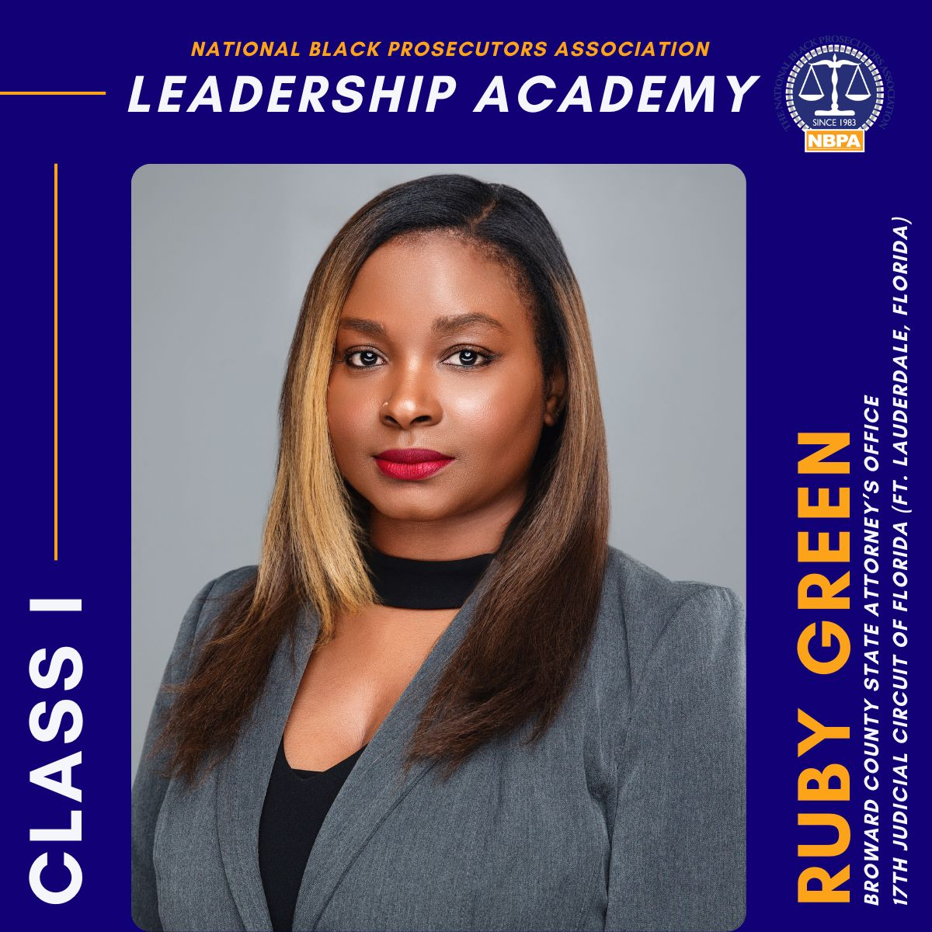

Slide 17
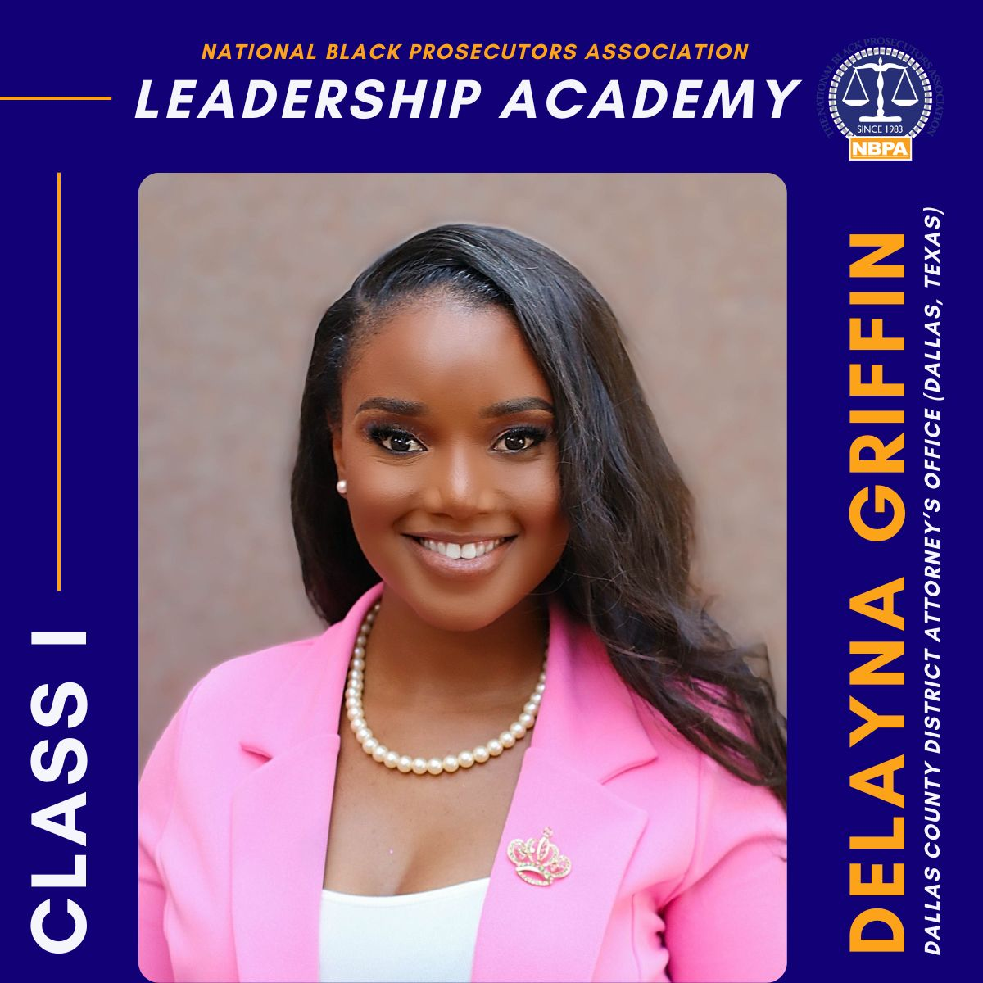

Slide 18
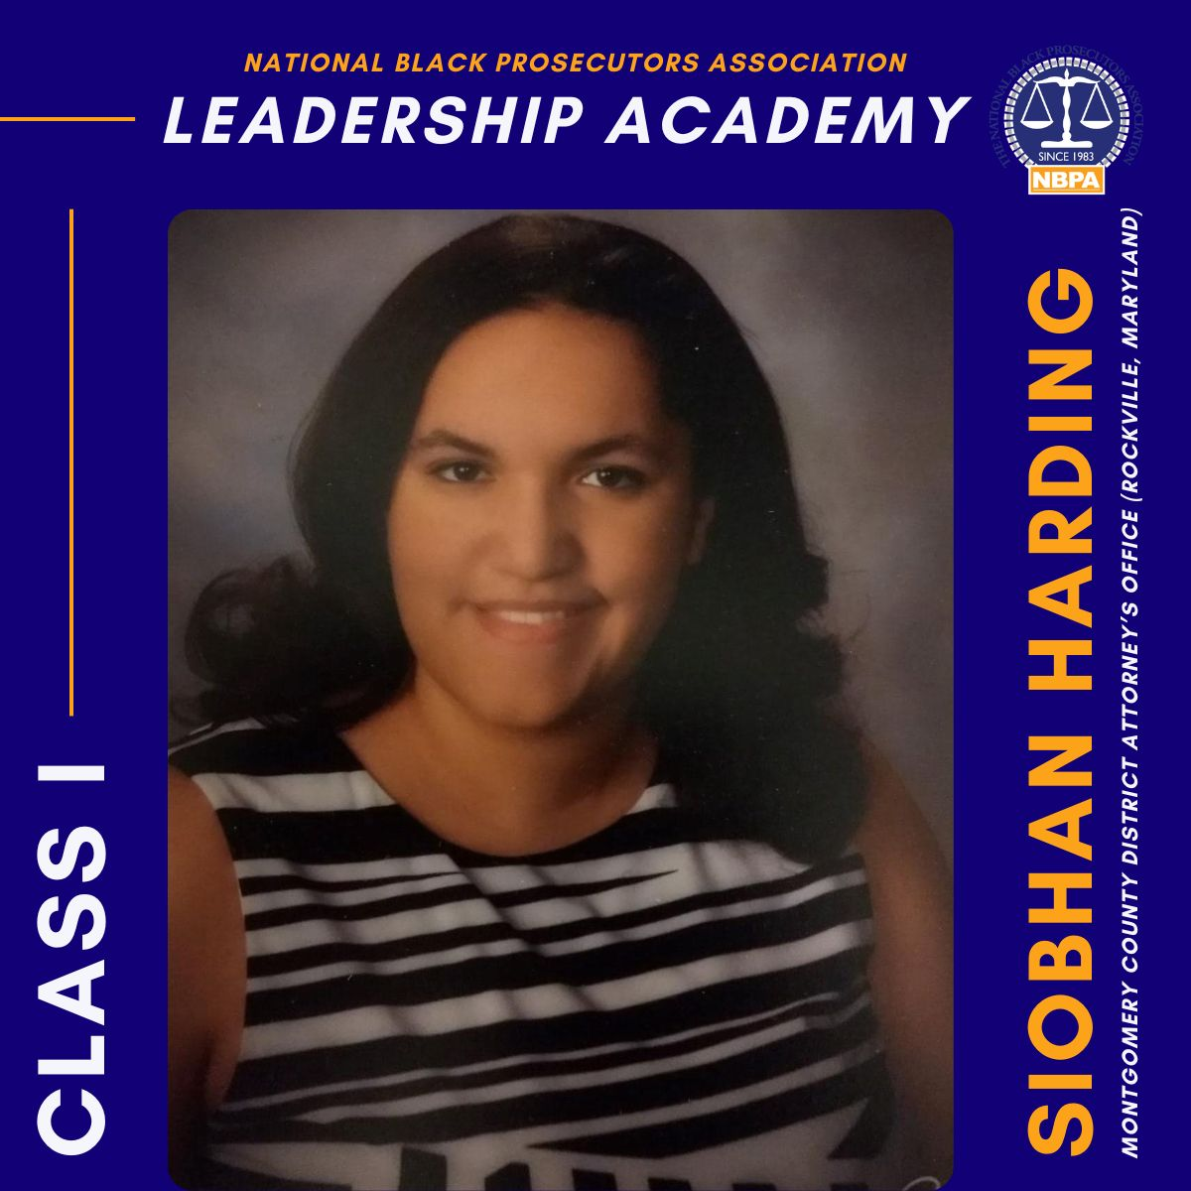

Slide 19
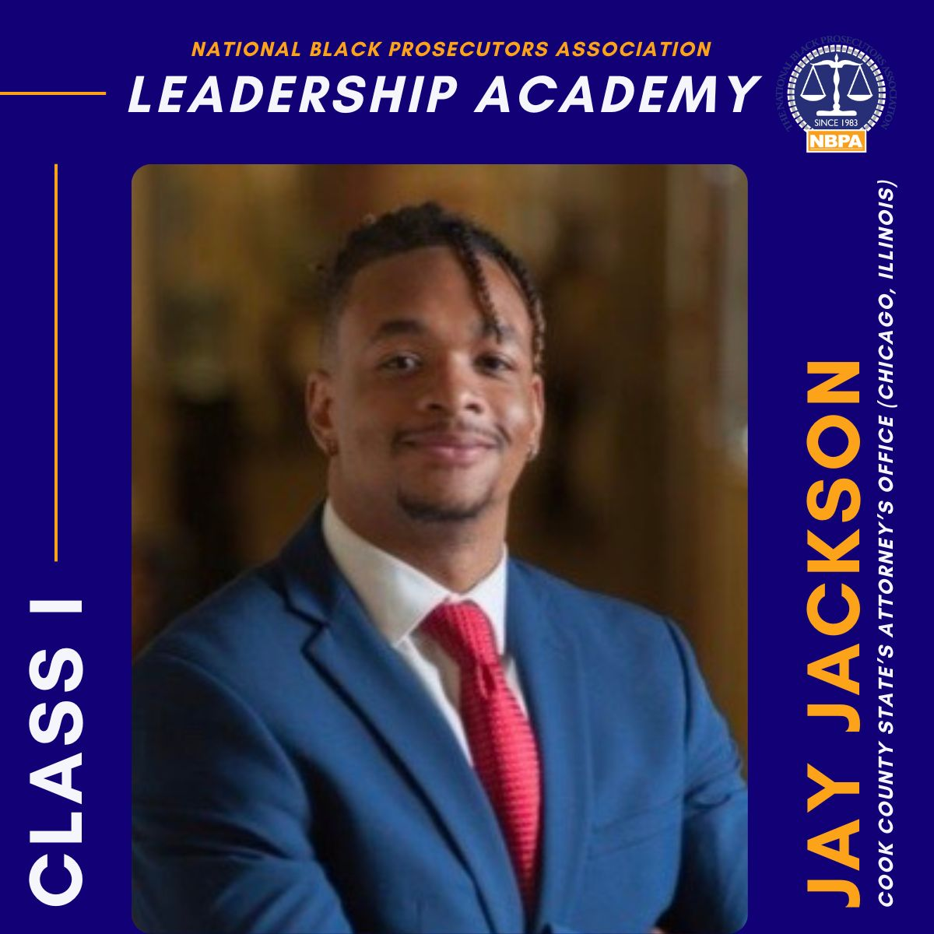

Slide 20
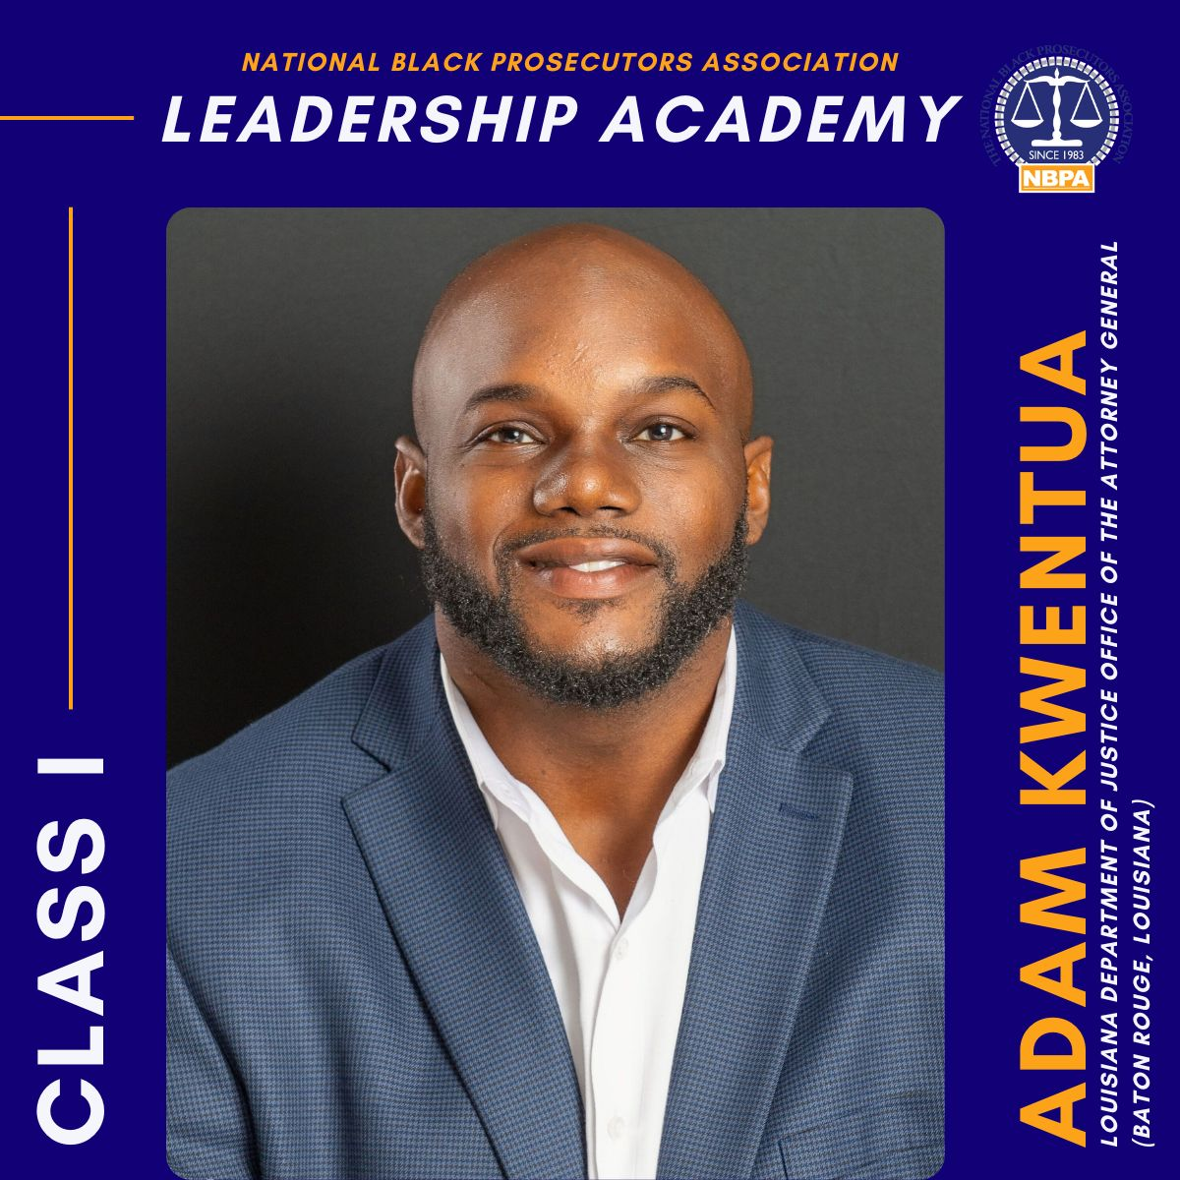

Slide 21
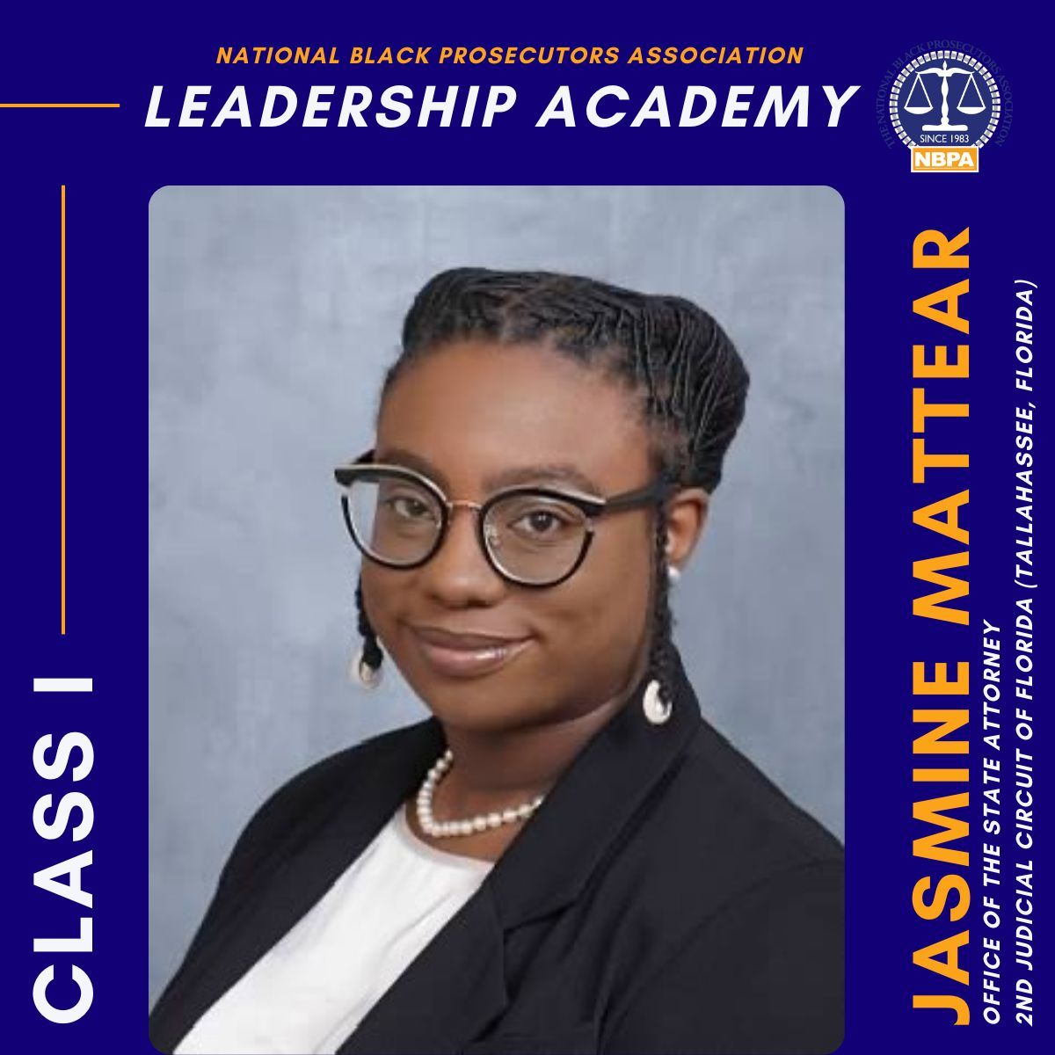

Slide 22
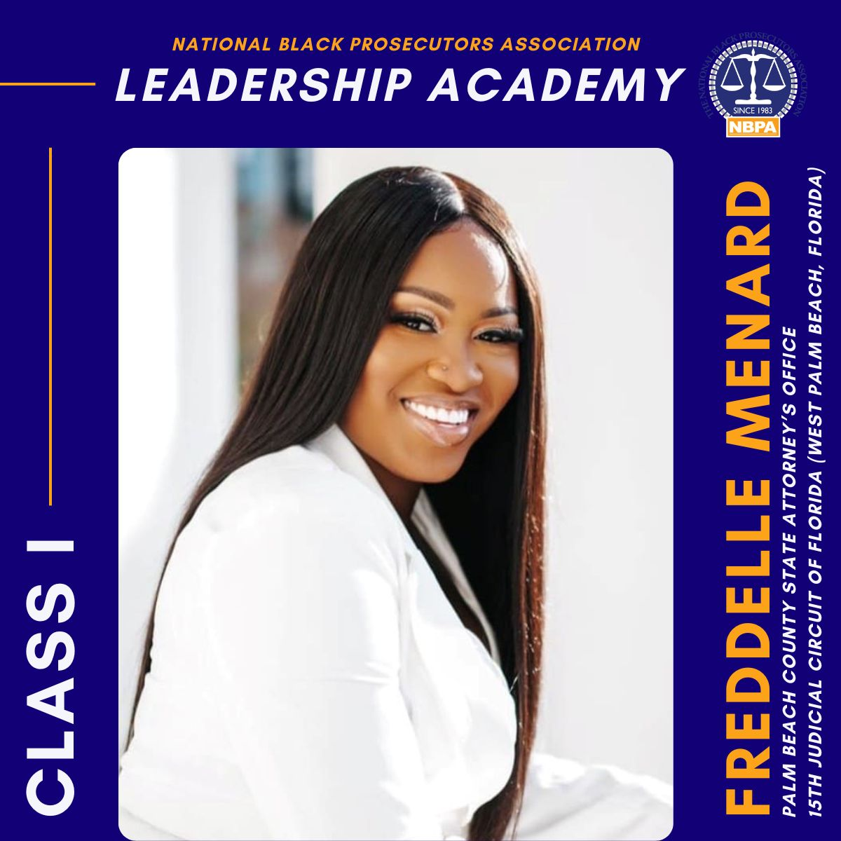

Slide 23
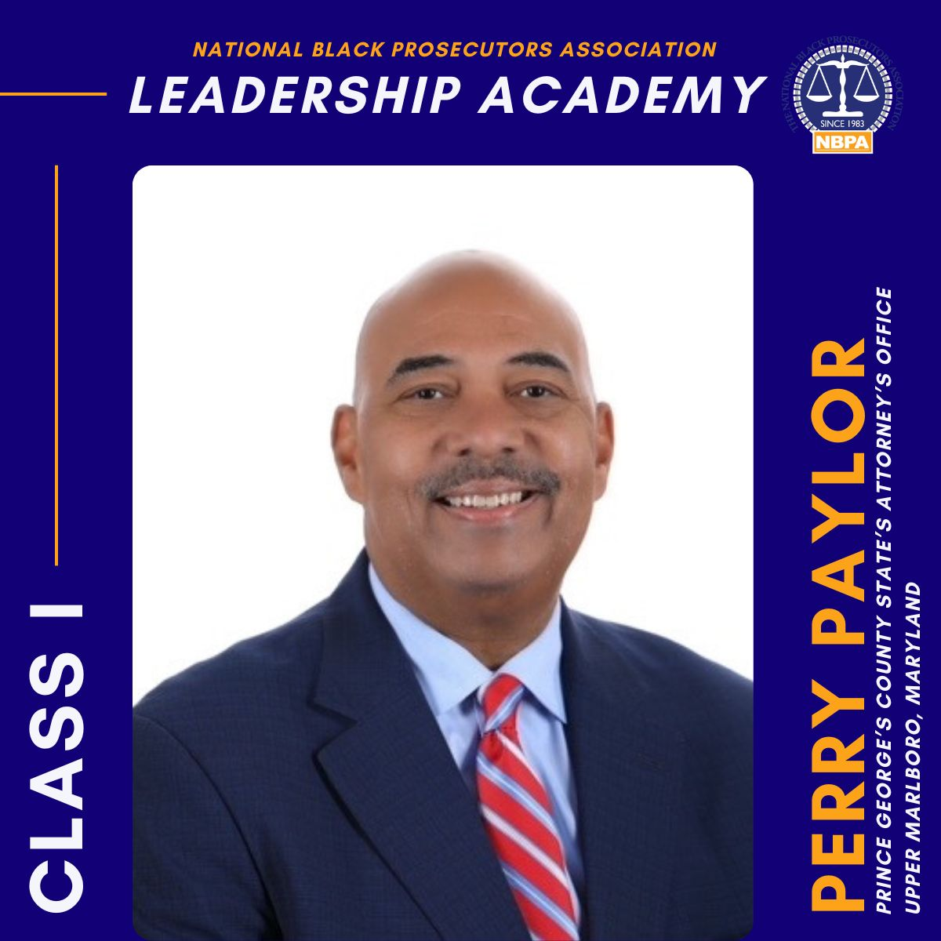

Slide 24
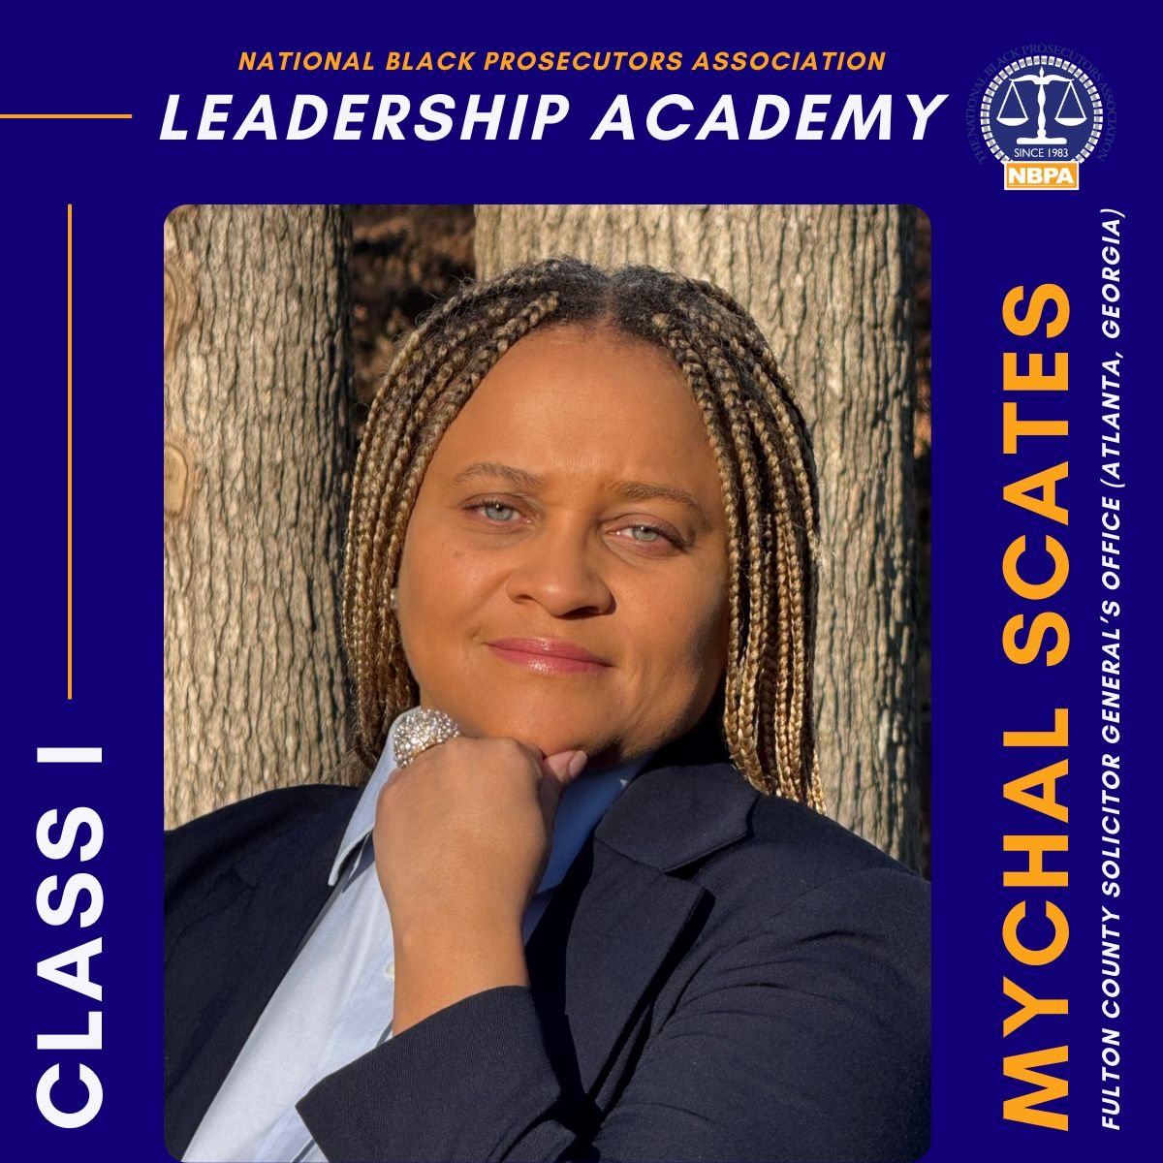

Slide 25
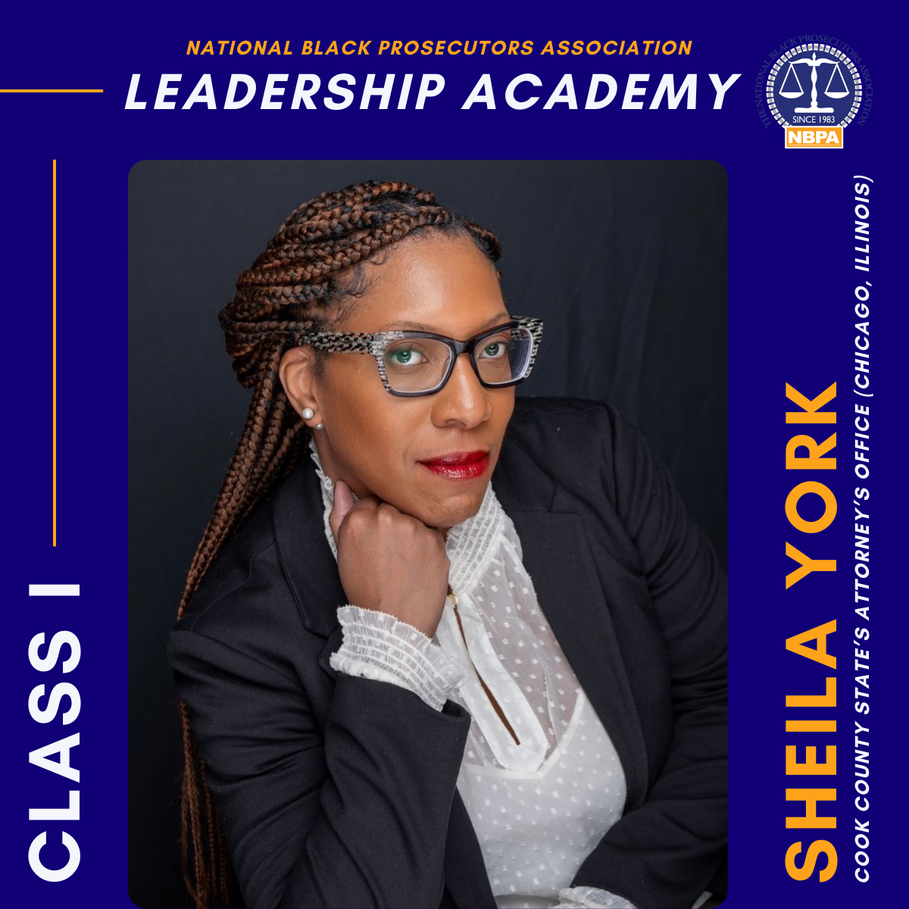

Slide 26
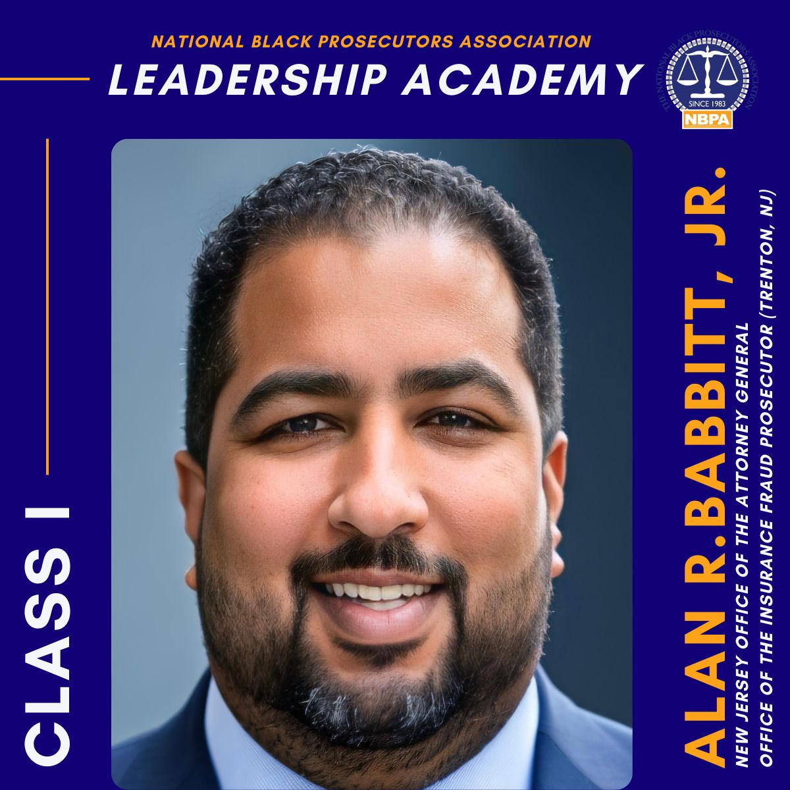

Slide 27
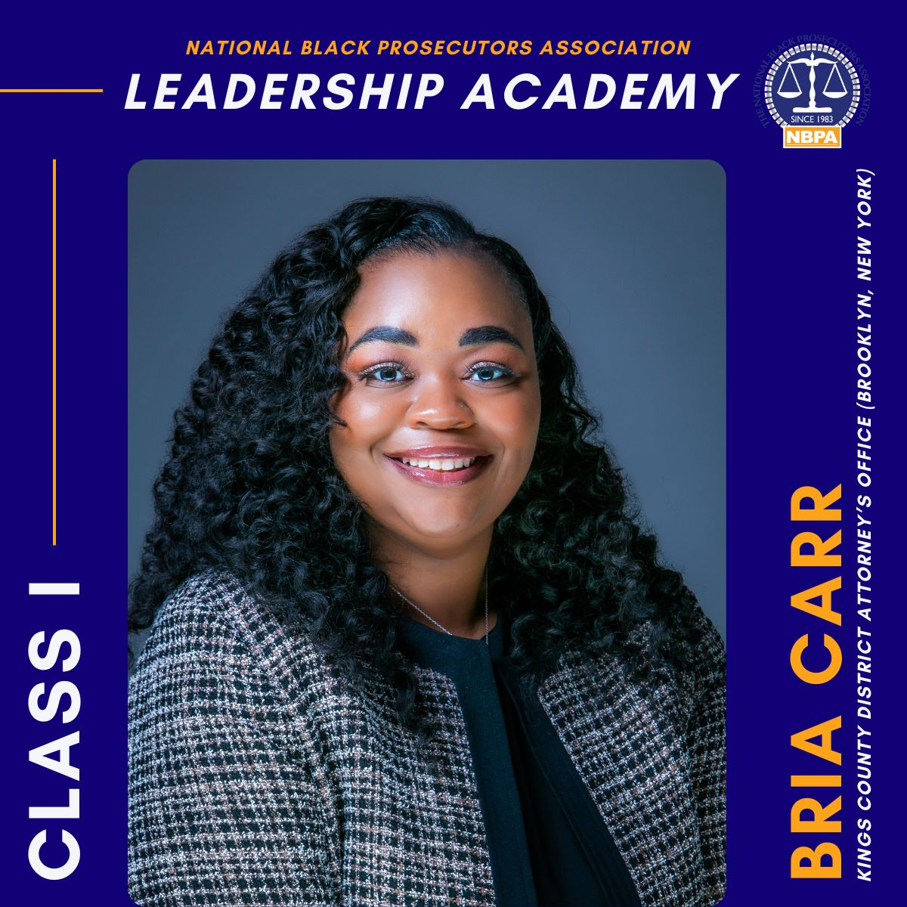

Slide 28
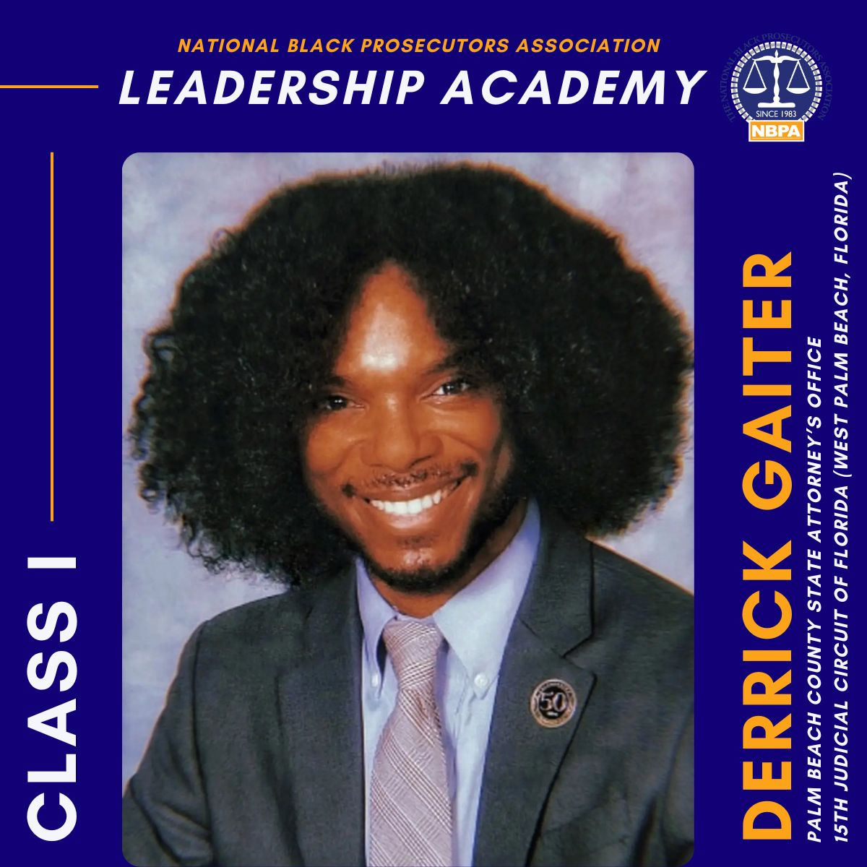

Slide 29
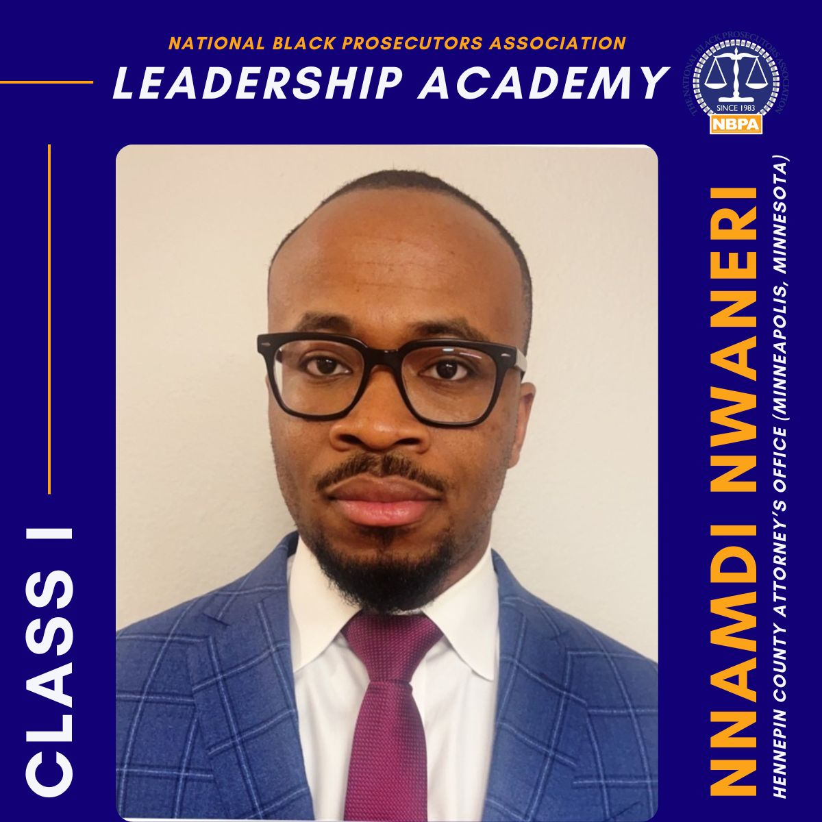

Slide 30
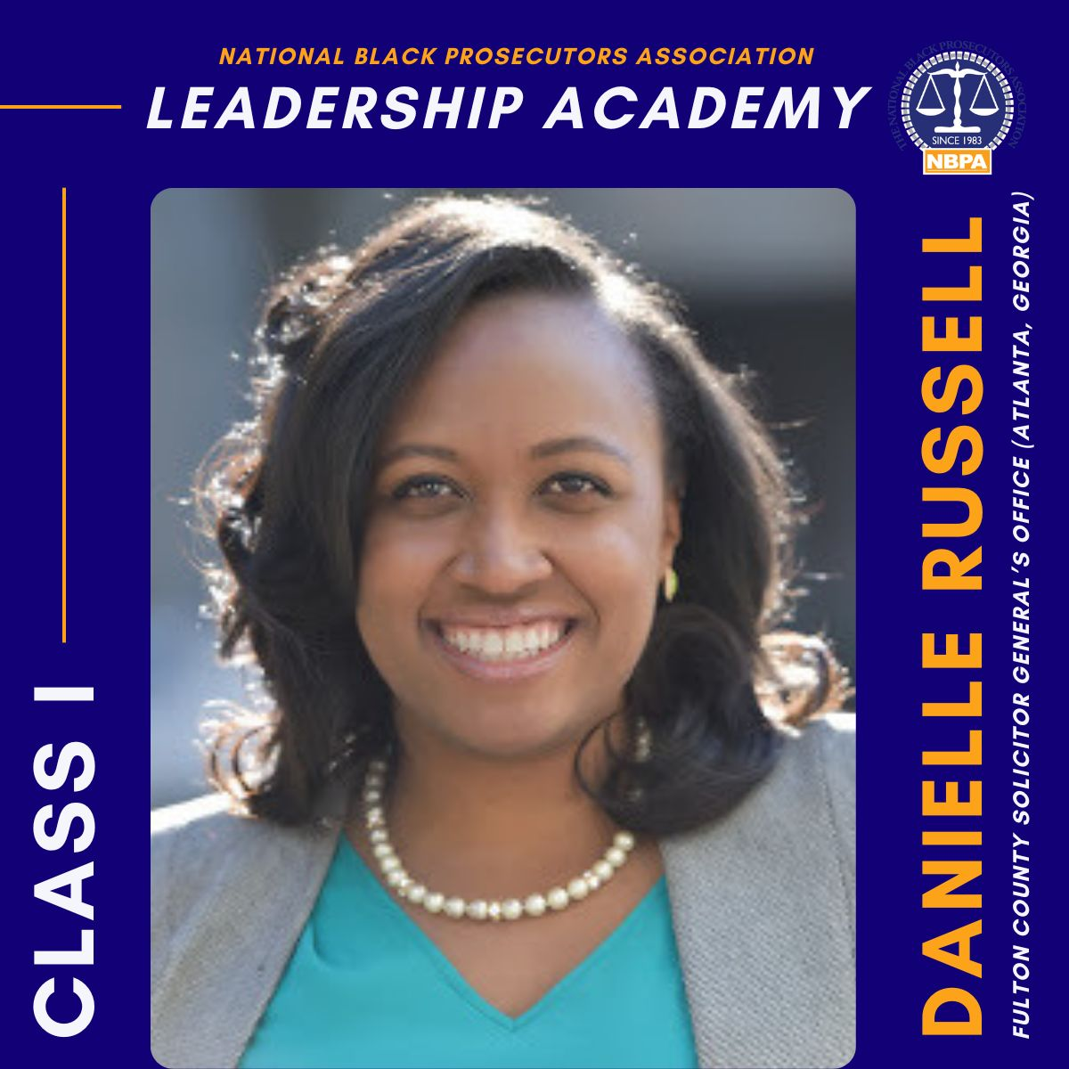

Slide 31
